Slide 1
DDPG
___________________________________________________________________________________________
深度決定性策略梯度
Deep Deterministic Policy Gradient, DDPG

Slide 2
DDPG: Outline
___________________________________________________________________________________________
Q-Learning
DQN
DDPG

Slide 3
DDPG: Q-Learning
___________________________________________________________________________________________
Q-Table
State
Q-Value
Action

Slide 4
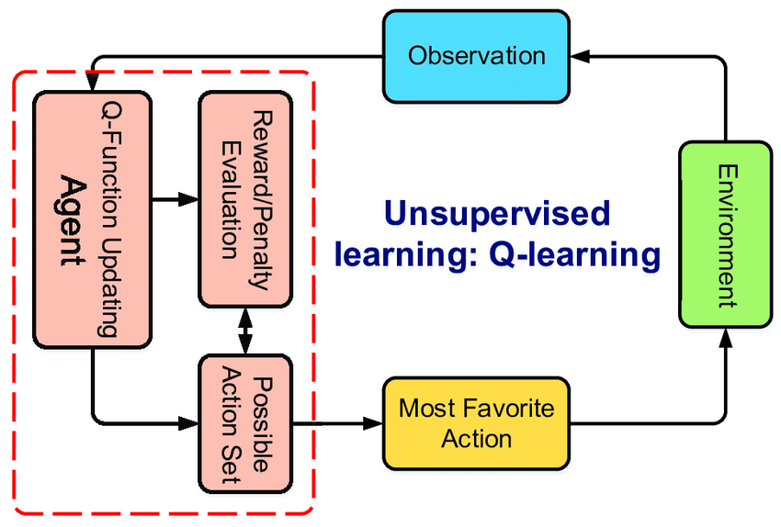
DDPG: Q-Learning
___________________________________________________________________________________________

Slide 5
DDPG: Problem of Q-Learning
___________________________________________________________________________________________
What if the Q-Table become too large?

Slide 6
DDPG: Q-Learning vs. DQN
___________________________________________________________________________________________
Q-Learning
Deep Q-Learning Network
Q-Table
Neural
Network
State
State
Action
Action
Q-Value
Q-Value

Slide 7
DDPG: Improvement
___________________________________________________________________________________________
在行為空間極大時：
模型計算時間可以得到顯著提升
模型學習所需樣本數可以顯著的降低

Slide 8
DDPG: DQN
___________________________________________________________________________________________
Q-Learning with Neural Network.

Slide 9
DDPG: Problem of DQN
___________________________________________________________________________________________
動作空間為離散空間：無法處理連續動作問題。
使用估值函數計價：收斂效率低、樣本效率低（學得慢）。

Slide 10
DDPG: The Core of DDPG
___________________________________________________________________________________________
Actor-Critic Algorigthm
Policy Gradient
Target Network

Slide 11
Intro: Actor Critic Algorithm
___________________________________________________________________________________________
Actor Network
Action
Critic
Network
Value
(Policy Gradient)
(Q-Learning)
Actor就像舞台上的演員，Critic則是台下的評審。

Slide 12
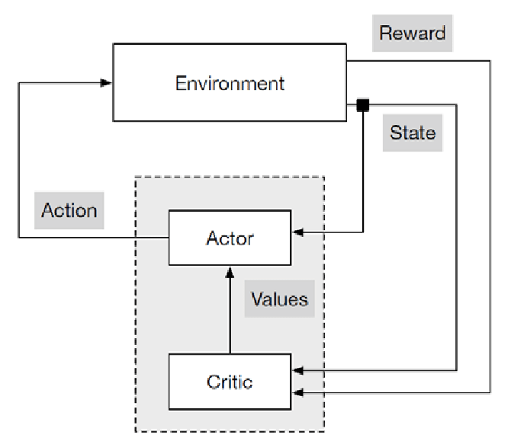
Intro: Actor Critic Algorithm
___________________________________________________________________________________________

Slide 13
DDPG: Target Network
___________________________________________________________________________________________
Actor Network
Critic Network
(Update θ)
(Update ⍵)
Current
Network
Current
Network
Target
Network
Target
Network
(Choose Action)
(Calculate Q-Value)

Slide 14
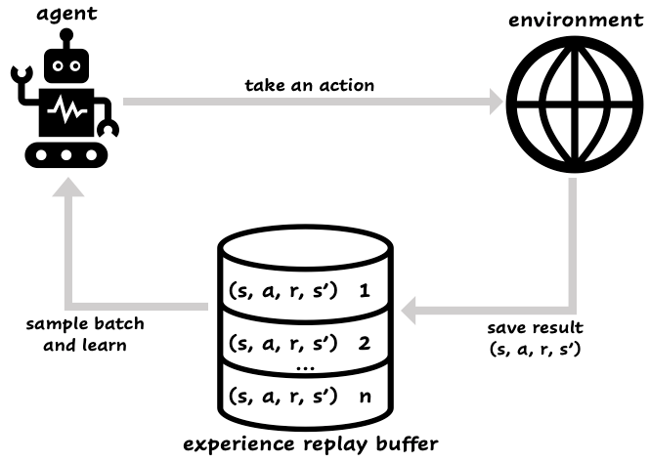
DDPG: Replay Buffer
___________________________________________________________________________________________

Slide 15
DDPG: Replay Buffer
___________________________________________________________________________________________
ReplayBuffer
push
sample
Add new experience
to the buffer
Randomly choose a batch size sample

Slide 16
DDPG: Architechture of DDPG (Simple)
___________________________________________________________________________________________
Randomly choose a batch size sample.
action’: actor_target(state’)
Q-value’: critic_target(state’, action’)
Replay Buffer
Update critic network.
Update actor network.
Update target critic network.
Update target actor network.

Slide 17
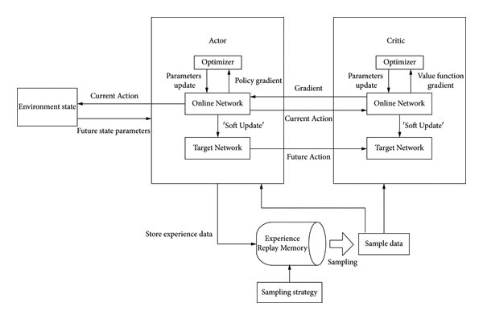
DDPG: Architechture of DDPG (Add Target network)
___________________________________________________________________________________________

Slide 18
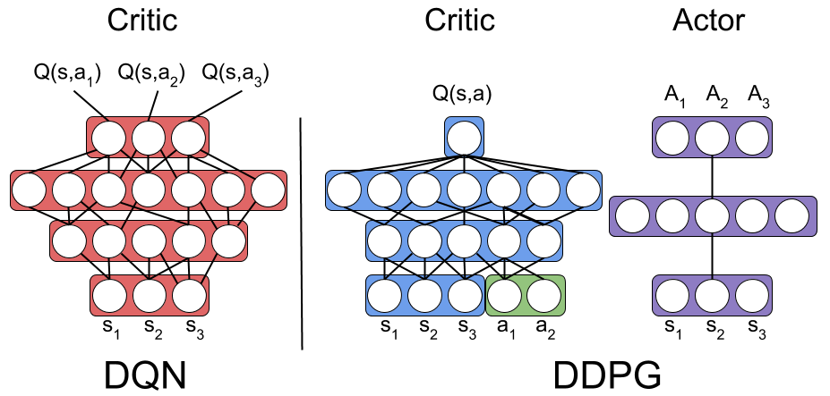
DDPG: DQN VS. DDPG
___________________________________________________________________________________________

Slide 19
DDPG: Improvement
___________________________________________________________________________________________
由於DDPG將DQN的Q-Table替換為AC架構，使得連續動作問題得以求解。
使用梯度下降法計價替代DQN中的估值計價，可以提高模型的收斂效率。

Slide 20
DDPG: DDPG
___________________________________________________________________________________________
Kind of DQN that can solve
continuosly action space problem.

